Slide 1
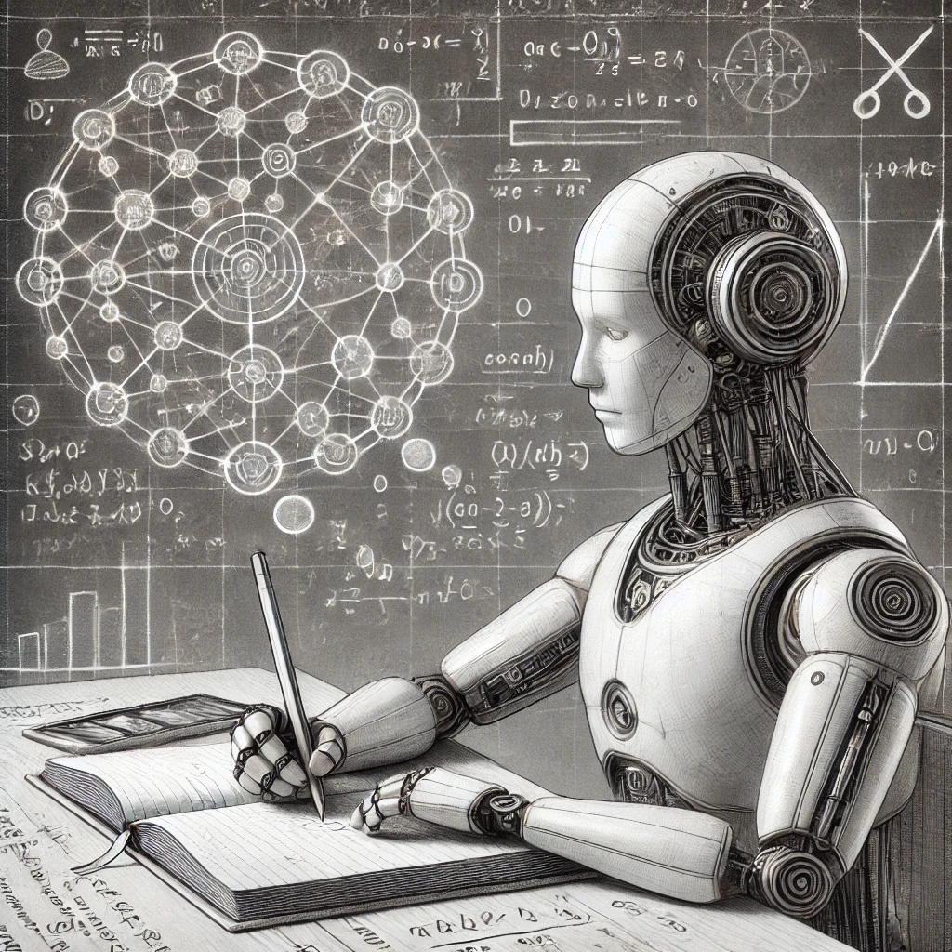
CIS 6200
Learning with Conditional Guarantees
Aaron Roth

Slide 2
Welcome! (Organizational Basics)
Professor: Aaron Roth
TA: Natalie Collina
Course Website: https://uncertaintyclass.com/
Class Communication: Slack --- if you aren’t already in the workspace, join from the website.
Format: Biweekly lectures. Active participation strongly encouraged --- we’re all learning together.

Slide 3
Welcome! (Organizational Basics)
Goal: To bring everyone up to and beyond the research frontier on a mathematical topic within learning theory.
No exams. Maybe a few problem sets.
Attendance/Participation
Primary deliverable: A semester long course project
  Ambition should be to produce novel/publishable research.
  Research is a team sport: Groups (2-4 people) encouraged.
  Last few weeks will be devoted to project presentations.
  Final report (~ 10 pages or more if needed) due during finals period.

Slide 4
Questions we will ask
When can we make forecasts that “look like” real probabilities in various ways, and how is this useful?
How can we quantify how sure we are about specific predictions?
When do these guarantees continue to hold when we zoom in on particular subsets of the data?
When can we safely make decisions downstream of our predictions by treating probabilistic predictions as if they were correct? i.e. when can we “trust” predictions?
What are minimal assumptions we need to make about data generating processes in order to get these guarantees?

Slide 5

How can we make sense of probabilities?
“What is the probability that if I flip a fair coin 16 times I get exactly 9 heads?”
  We have a mathematical model that maps well onto reality; we can compute this in closed form.
  We can also conduct the experiment repeatedly and empirically estimate.

Slide 6
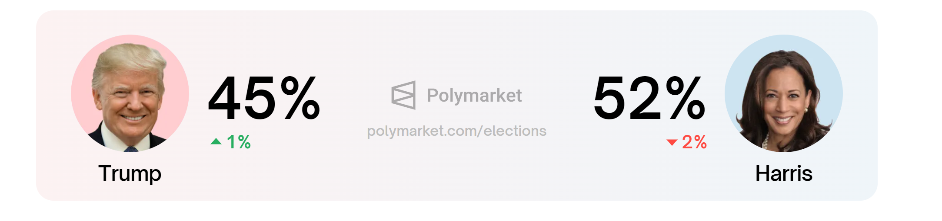
How can we make sense of probabilities?
“What is the probability that Kamala Harris wins the 2024 US Presidential election?”
  If we posit a probabilistic model of the universe, this is perhaps philosophically coherent, but it is not a repeatable event; we can’t get empirical estimates.

Slide 7
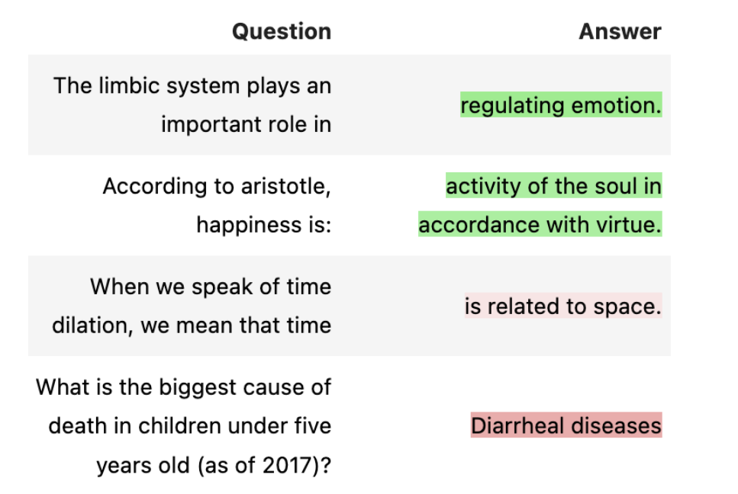
How can we make sense of probabilities?
“ChatGPT says that the leading cause of death globally in children under five years old is Diarrheal diseases. What is the probability that it is correct?”
  This is either correct or not, and (with some research) is knowable. But it would still be useful to have “confidence scores” for LLMs…

Slide 8
Individual Probabilities Pervade ML
In the practice of ML and statistics we frequently refer to individual probabilities:
  “The probability that it will rain tomorrow” (weather forecasting)
  “The probability that Alice will die in the next 12 months” (life insurance)
  “The probability that Bob will be arrested for a violent crime 18 months after release on parole” (recidivism prediction)
  “The probability that Carol will develop breast cancer before the age of 50” (predictive medicine)
  …

Slide 9
The measurement problem
Individual probabilities refer to a model of the world in which there is some distribution $D$ over feature/outcome pairs $\left(x,y\right)∈X×\{0,1\}$.
  Within the model, an individual probability of an outcome for an individual with observable features $x$ is: $p\left(x\right)=\underset{D}{Pr}\left[y=1 \right|x]$,
  Model is consistent with determined outcomes (e.g. $p\left(x\right)∈\{0,1\}$)
The Basic Problem:
  We observe each individual at most once, and so cannot measure individual probabilities.
  All we can measure are averages over sufficiently large sets $S⊆X$:
  $$p\left(S\right)=\underset{D}{Pr}\left[y=1 \right|x∈S]$$
    (The more data we have, the smaller the sets $S$ we can estimate $p(S)$ for).
Given this, what are we to make of individual probabilities?

Slide 10
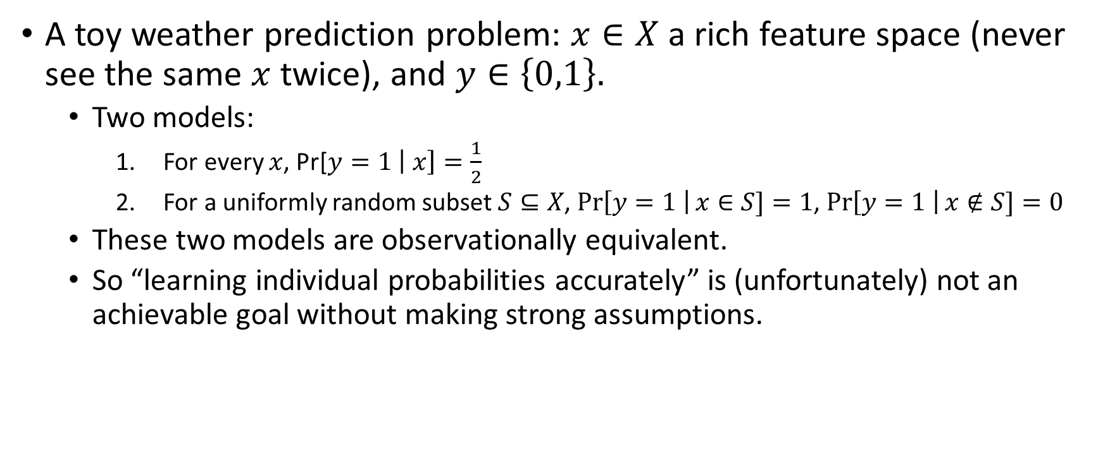
Can’t even distinguish a randomized from a deterministic world.
A toy weather prediction problem: $x∈X$ a rich feature space (never see the same $x$ twice), and $y∈\left\{0,1\right\}.$
  Two models:
    For every $x$, Pr[$y=1 \left| x\right]=\frac{1}{2}$
    For a uniformly random subset $S⊆X$, $\operatorname{Pr}\left[y=1 \right|x∈S]=1$, $\operatorname{Pr}\left[y=1 \right|x∉S]=0$
  These two models are observationally equivalent.
  So “learning individual probabilities accurately” is (unfortunately) not an achievable goal without making strong assumptions.

Slide 11
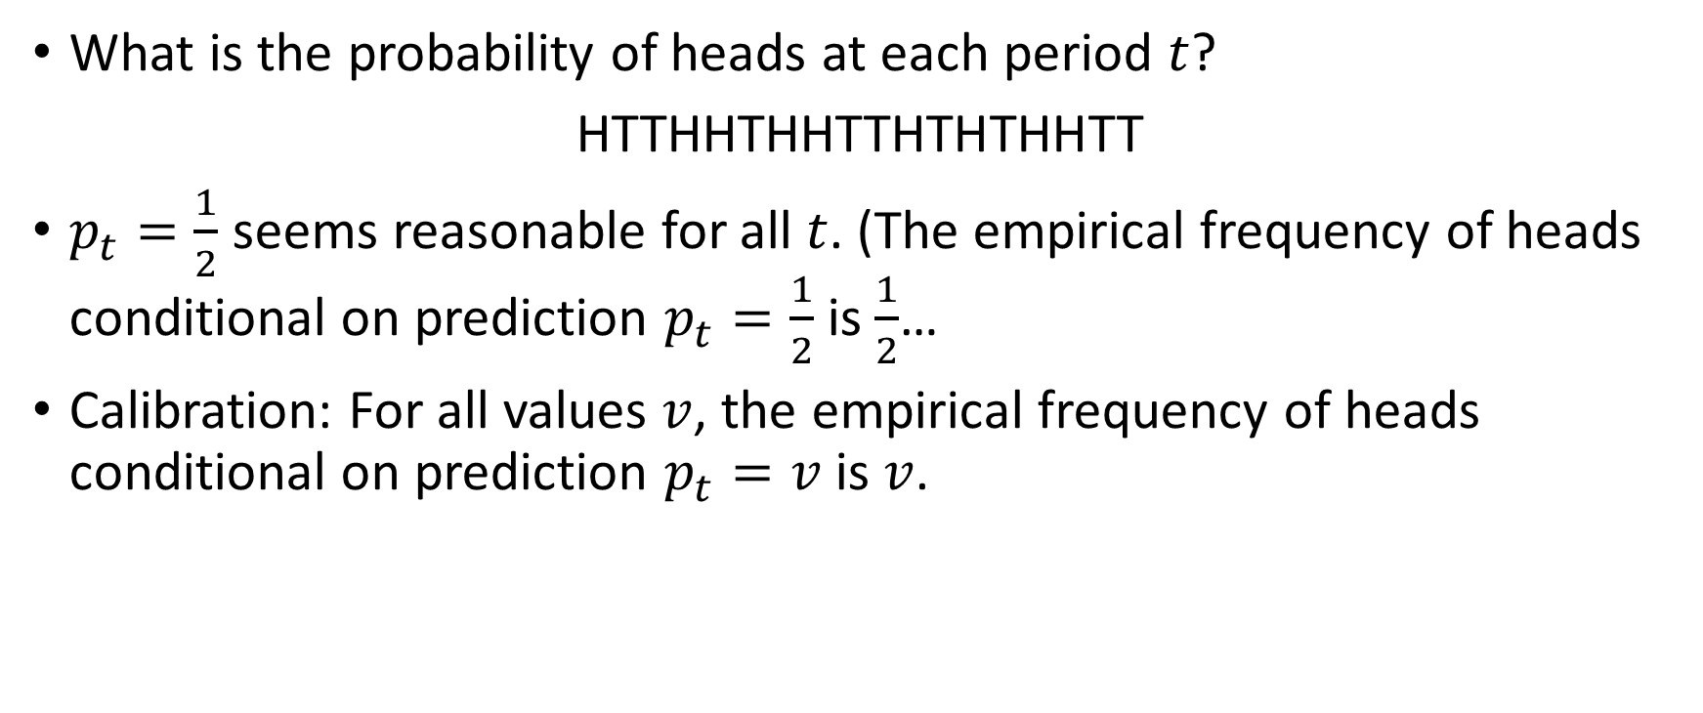
Calibration: Level-0 Consistency
What is the probability of heads at each period $t$?
HTTHHTHHTTHTHTHHTT
$p_{t}=\frac{1}{2}$ seems reasonable for all $t$. (The empirical frequency of heads conditional on prediction $p_{t}=\frac{1}{2}$ is $\frac{1}{2}$…
Calibration: For all values $v$, the empirical frequency of heads conditional on prediction $p_{t}=v$ is $v$.

Slide 12
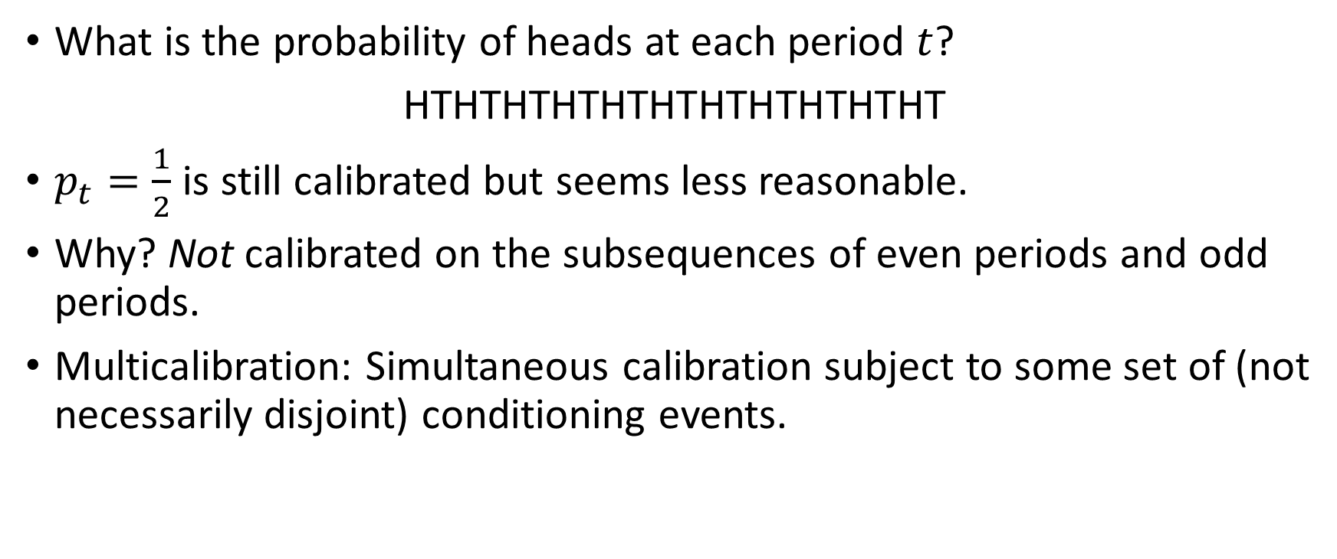
Multicalibration: More Consistency Constraints
What is the probability of heads at each period $t$?
HTHTHTHTHTHTHTHTHTHTHT
$p_{t}=\frac{1}{2}$ is still calibrated but seems less reasonable.
Why? Not calibrated on the subsequences of even periods and odd periods.
Multicalibration: Simultaneous calibration subject to some set of (not necessarily disjoint) conditioning events.

Slide 13
Beyond Means
Calibration is about predicting averages, but can also ask for collections of consistency constraints for other losses/distributional quantities.
E.g. quantiles are useful for uncertainty quantification.
General philosophy: If predictions are indistinguishable from real probabilities with respect to a certain class of tests, then they are as good as real probabilities for any application that only interacts with them using tests from that class.

Slide 14
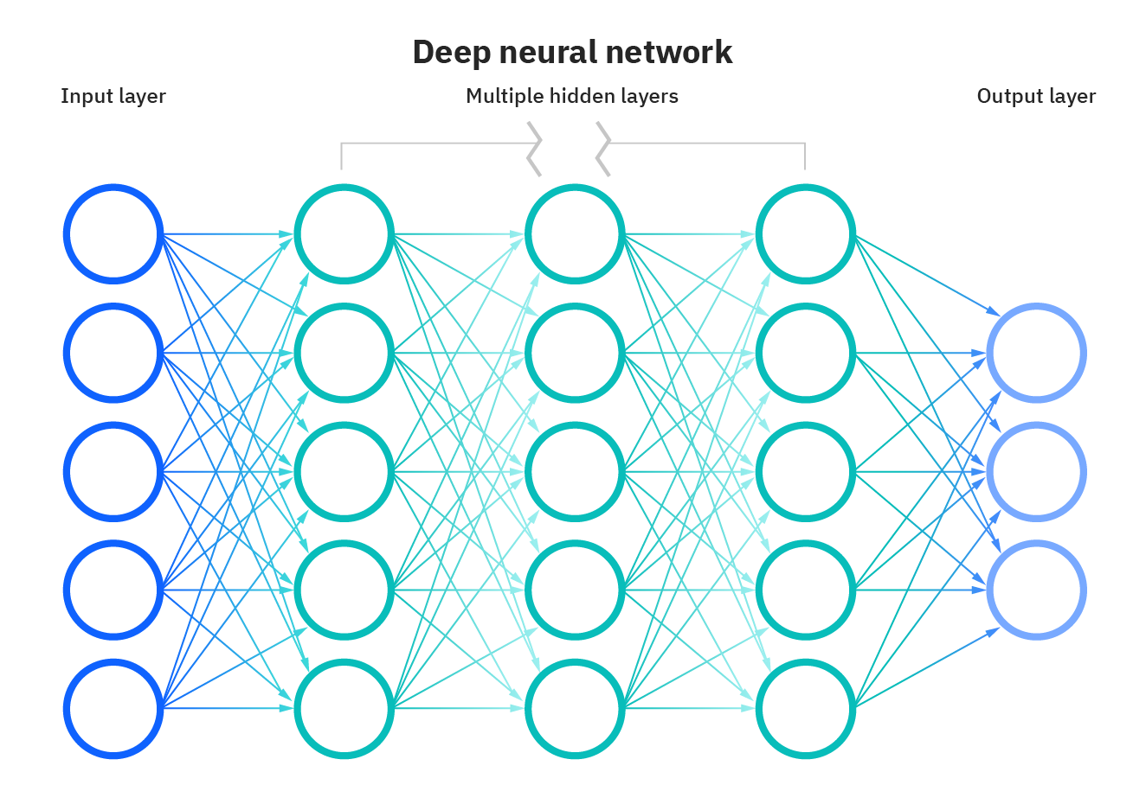
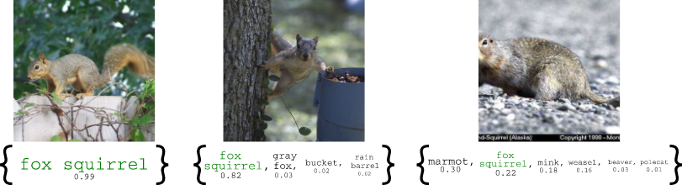
Prediction Sets
We have many black box methods that can make predictions.
Which predictions should we feel confident in?
Need a way of quantifying uncertainty. One way: prediction sets.
Image from Angelopoulos, Bates, Malik, Jordan ICLR 2021
Goal: The prediction set should contain the true label with probability (e.g.) 95%.

Slide 15



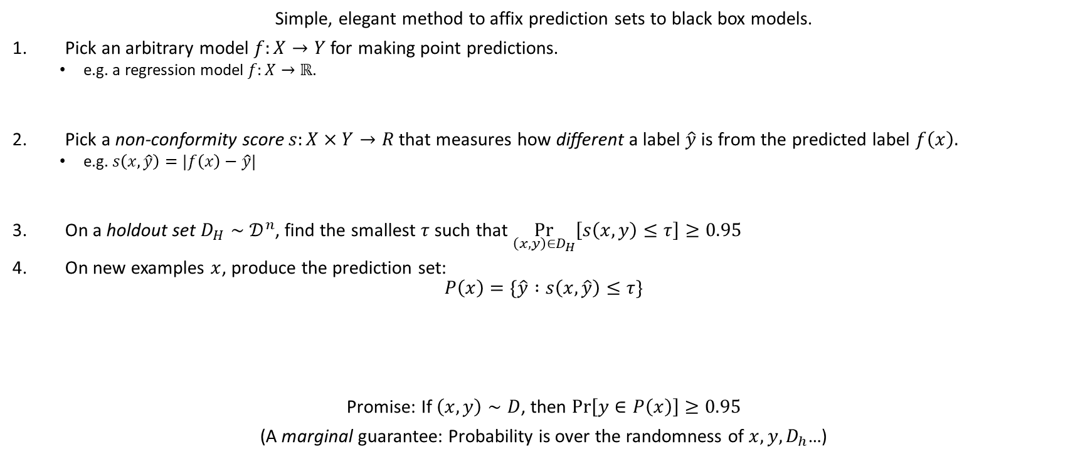



Conformal Prediction [Shafer, Vovk]
Simple, elegant method to affix prediction sets to black box models.
Pick an arbitrary model $f:X→Y$for making point predictions.
  e.g. a regression model $f:X→ℝ$.
Pick a non-conformity score $s:X×Y→R$ that measures how different a label $\hat{y}$ is from the predicted label $f\left(x\right).$
  e.g. $s\left(x,\hat{y}\right)=|f\left(x\right)−\hat{y}|$
On a holdout set $D_{H}∼𝒟^{n}$, find the smallest $τ$ such that $\underset{\left(x,y\right)∈D_{H}}{Pr}\left[s\left(x,y\right)≤τ\right]≥0.95$
On new examples $x$, produce the prediction set:
$$P\left(x\right)=\{\hat{y} :s\left(x,\hat{y}\right)≤τ\}$$
Promise: If $\left(x,y\right)∼D$, then $\operatorname{Pr}\left[y∈P\left(x\right)\right]≥0.95$
(A marginal guarantee: Probability is over the randomness of $x, y, D_{h}$…)
$$f(x)$$
$$s(x,y)$$
$$f(x)$$
$$y$$
$$f\left(x\right)−τ$$
$$f(x)$$
$$f\left(x\right)+τ$$

Slide 16

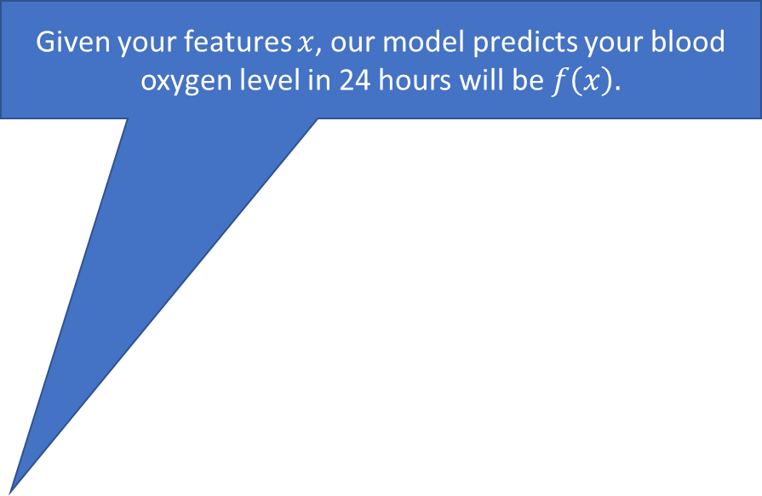
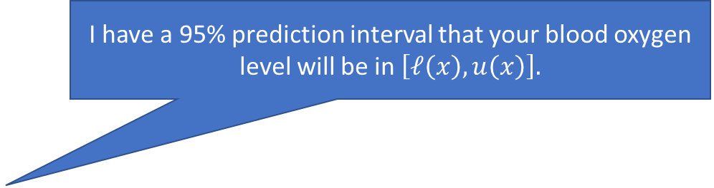
What’s wrong with marginal guarantees?
Given your features $x$, our model predicts your blood oxygen level in 24 hours will be $f\left(x\right).$
How sure are you?
I have a 95% prediction interval that your blood oxygen level will be in $\left[ℓ\left(x\right),u\left(x\right)\right].$
Hmmm…

Slide 17

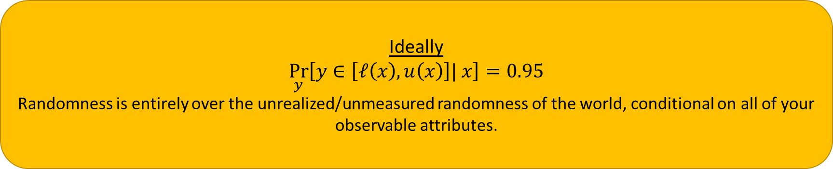
What’s wrong with marginal guarantees?
Ideally
$$\underset{y}{Pr}\left[y∈\left[ℓ\left(x\right),u\left(x\right)\right]| x\right]=0.95$$
Randomness is entirely over the unrealized/unmeasured randomness of the world, conditional on all of your observable attributes.
Conformal Prediction
Marginal Coverage:$\underset{(x,y)}{Pr}\left[y∈\left[ℓ\left(x\right),u\left(x\right)\right]\right]=0.95$
Randomness is averaging over people.

Slide 18
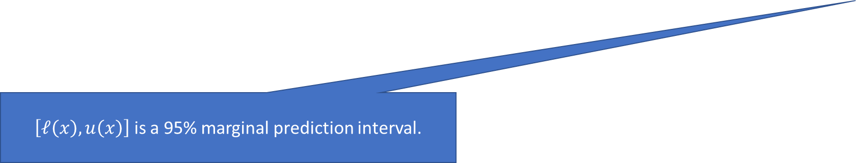
Marginal Guarantees.
$\left[ℓ\left(x\right),u\left(x\right)\right]$ is a 95% marginal prediction interval.
But I’m part of a demographic group representing less than 5% of the population…
For disjoint groups, could just calibrate separately on each group
[Romano, Foygel-Barber, Sabatti, Candes ‘20]
But…

Slide 19
Marginal Guarantees.
What about for people like me?
For African Americans under the age of 50 the 95% prediction interval is [a,b]
For women with a family history of diabetes the 95% prediction interval is [c,d]
What does this mean for me?
For people with egg allergies and no history of smoking, the 95% prediction interval is [e, f].

Slide 20
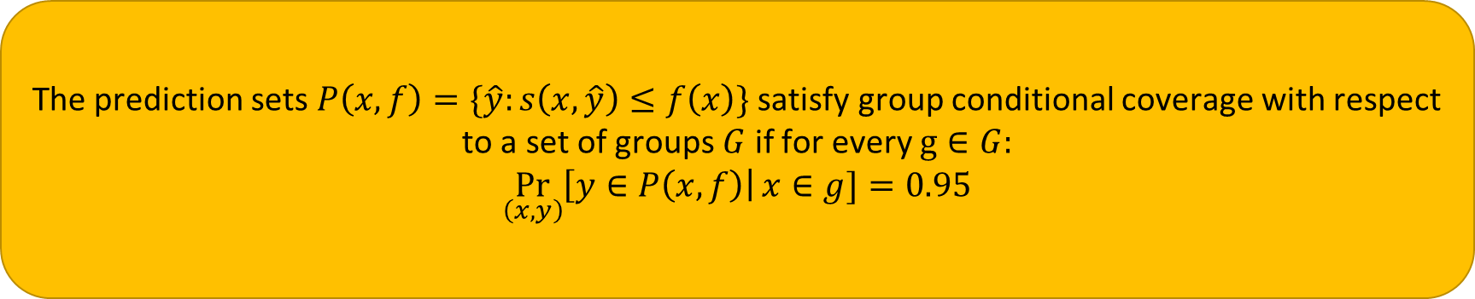
Multicalibrated quantile estimation can give:
The prediction sets $P\left(x,f\right)=\{\hat{y}:s\left(x,\hat{y}\right)≤f\left(x\right)\}$ satisfy group conditional coverage with respect to a set of groups $G$ if for every $g∈G:$
$$\underset{\left(x,y\right)}{Pr}\left[y∈P\left(x,f\right)\right|x∈g]=0.95$$

Slide 21
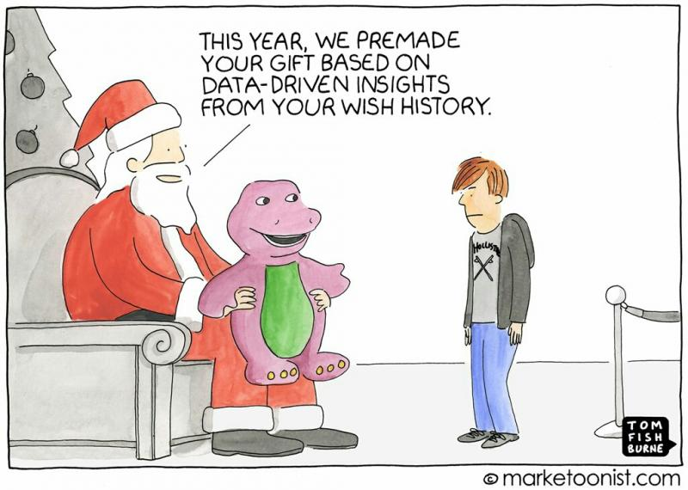
Distributional Assumptions
Standard Assumption for Conformal Prediction:
  Exchangeability (e.g. iid data): The future must look like the past.
But this is often violated:

Slide 22

Distributional Assumptions
We will see how much we can do with no assumptions on the data generating process: data arrives sequentially, selected by an adversary.
It will turn out we can do quite a lot --- close connections with game theory and the minimax theorem.

Slide 23

A (Rough) Roadmap
Simple Marginal Guarantees
  Marginal Mean Consistency improves squared error
  Marginal Quantile Consitency improves pinball loss
  Marginal Quantile Consistency is already useful for conformal prediction.

Slide 24
A (Rough) Roadmap
From marginal guarantees to calibration
  Mean calibration: Marginal mean consistency conditional on mean prediction.
  Quantile calibration: Marginal quantile consistency conditional on quantile prediction
Why calibration?
  A decision-theoretic interpretation as “trustworthiness”

Slide 25
A (Rough) Roadmap
Adding more conditioning events.
  Group Conditional Mean Calibration
    (Gradient Descent on Squared Loss)
  Group Conditional Quantile Calibration
    (Gradient Descent on Pinball Loss)
  Decision Calibration and (Swap) Regret

Slide 26
A (Rough) Roadmap
Interlude! Zero Sum Games and the Minimax Theorem
  Intro to Zero Sum Games
  Proving the Minimax Theorem via Sequential Decision Making
  Computing Minimax Strategies via Sequential Decision Making
Application of the Minimax Theorem: Passing any empirical test in an adversarial environment.
  Existential proof of sequential calibration algorithms with guarantees against adversaries --- and much more.

Slide 27
A (Rough) Roadmap
Multiobjective Sequential Learning:
  A General Game Theoretic Framework for Multiobjective Learning
  Efficiently Controlling Regret Across Multiple Subsequences
  Efficiently Making (Multi)calibrated Predictions Against an Adversary

Slide 28
A (Rough) Roadmap
Some Applications:
  Predicting for many loss functions (“Omniprediction”)
  Accuracy under distribution shift (“Universal Adaptability”)
  Ensembling and Agreement
    Resolving the “Reference Class Problem at Scale”
    Generalizations of Aumann’s Agreement Theorem
  Boosting for Squared Error Regression
  More?

Slide 29


